Slide 1
ANALYSIS NEW YORK CITY
RENT
A PRESENTATION BY TEAM NEBULA
Aayush Bakre, Ajanya Sharma

Slide 2
WHOA!
Get prepared to be amazed by great findings from our very own
New York City!

Slide 3
TABLE OF CONTENT
INTRODUCTION
Data processing
01
02
ANALYSIS & Visualization
PRESCRIPTION MODEL
03
04
Get to know the scope of the project
An overview of our approach towards the data
Our analysis of the data and related findings
Demonstrating our prescription model for rental apartments

Slide 4
INTRODUCTION
This project attempts to gather insights and make prescriptions based on the residential rental data in New York city across all of its boroughs.

Slide 5
OFF
WITH AN INTRODUCTION
01
STARTING
Get to know the scope of the project

Slide 6

THE Objective statement
To gather insight from the rental distribution of various apartment types in New York City from the last 5 years
To prescribe the most favourable area to buy a specific apartment type within a budget

Slide 7
PROBLEM VS SOLUTION
TOO MANY OPTIONS
FIND THE BEST FIT
FACT #2
Manhattan & Brooklyn see the most rental inquiries in NYC
There’s too much to look at when you’re looking for a new place to rent
VS
Find the right area that fits a budget and apartment type
FACT #1
70% of residents in New York City are on rentals

Slide 8
PROCESSING
02
DATA
An overview of our approach towards data

Slide 9
THE PROCESS
Collection
CleanSing
Mapping
Collection of relevant pieces of data from multiple sources
The process of detecting and correcting corrupt or inaccurate records
The process of creating data element mappings between two distinct data models

Slide 10
DATA Collection sources
NYC Open data
kaggle
Data world
The rental data, zip codes and facility's data such as airports, hospitals and transits was taken from this source.
Data for schools in all boroughs was collected from this source
Data for restaurants & parks in all boroughs was collected from this source

Slide 11
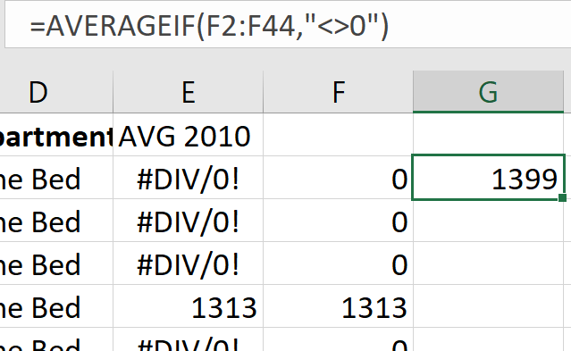
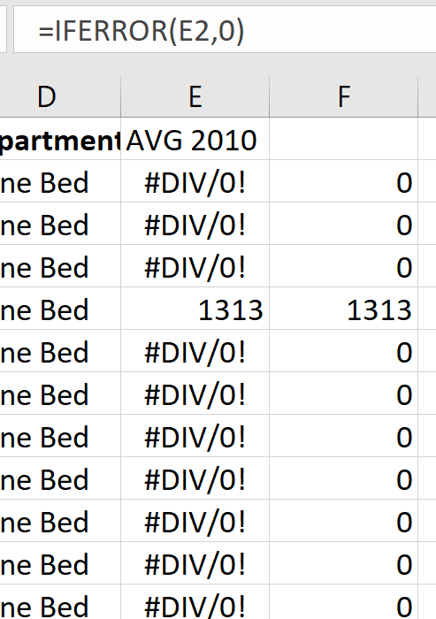
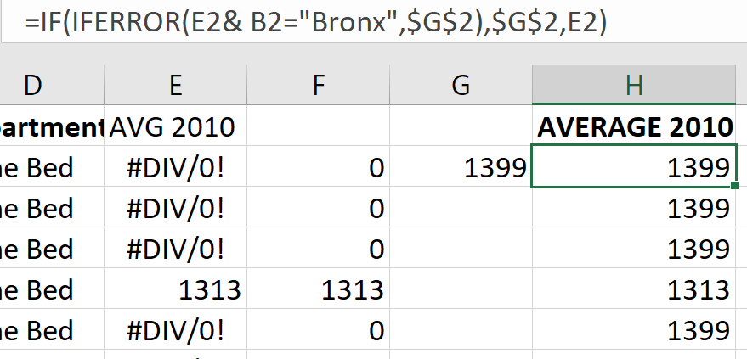
DATA Cleansing
Cleaning was done for some files on Tableau Prep and some on Excel.
Remove unwanted columns for example cross streets and also to remove unwanted spaces.
Identify error fields using IFERROR, populate them by 0 and then average the rest cells to arrive at a mean rent.
Also, in rental files missing data was filled by determining average median rents available and using randbetween function.

Slide 12
OTHER PROCESSING
Retrieving missing zip codes for areas in NYC: This was done by using Geopy in python. Geopy is a Python client for several popular geocoding web services.
Mapping of zip codes with rental areas and facilities areas and combining multiple data sets in a single excel file for visualization.
Remove duplicate rows from restaurants file using data tab ---> remove duplicate entries in excel.

Slide 13
& VISUALIZATIONS
03
ANALYSIS
Our analysis of the data and related findings

Slide 14

WHAT TO EXPECT? The last couple of years have been outliers in rental trends
RENTALS?

Slide 15
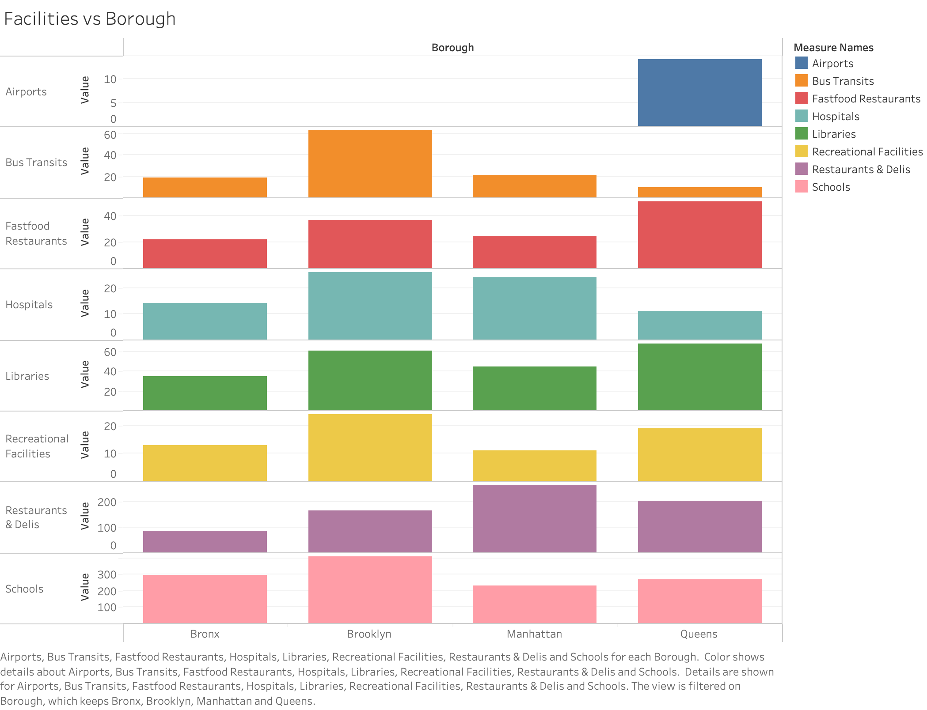
VS BOROUGHS
Data ANALYSIS
FACILITIES
FINDINGS
Schools & Libraries have a similar distribution across all boroughs
Brooklyn has the highest concentration of most facilities
All airports are in Queens

Slide 16
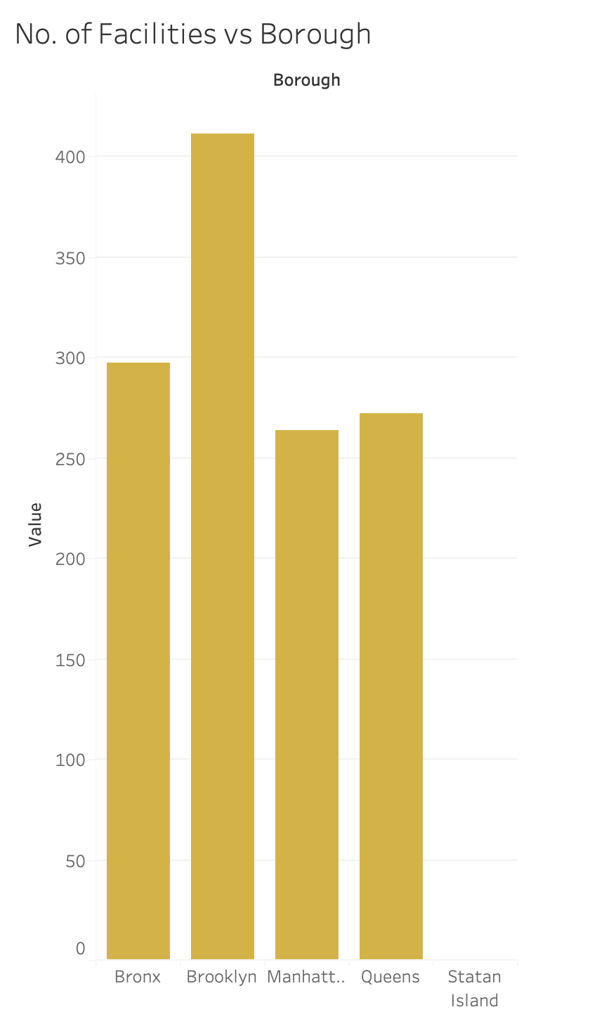
VS BOROUGHS
No. of FACILITIES
FINDINGS
Brooklyn has the highest number of facilities followed by Bronx, Queens, Manhattan & Staten Island

Slide 17
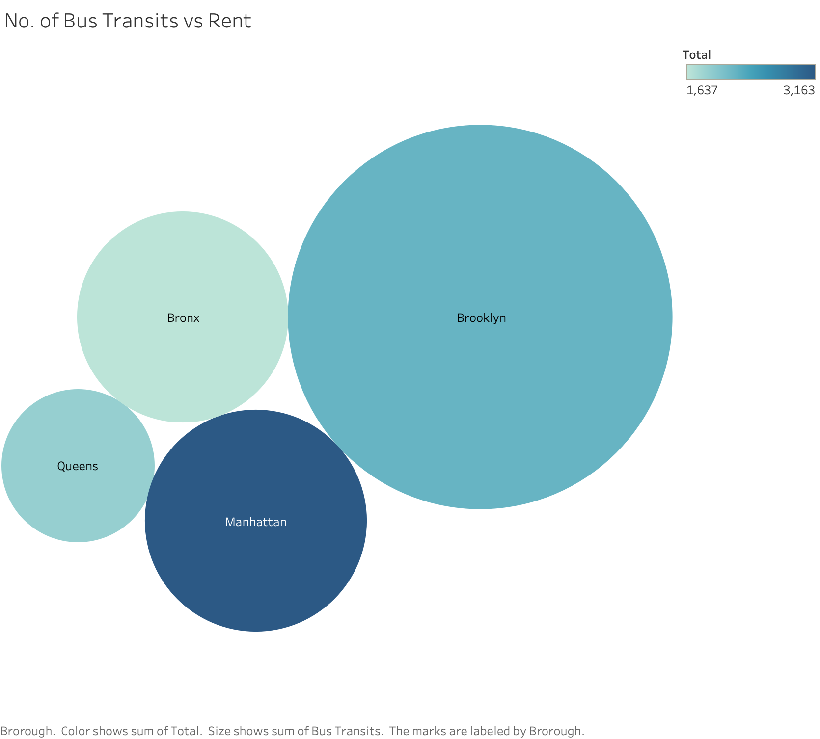
VS No. of BUS/Rail Transits
RENT
FINDINGS
Brooklyn has the highest amount of Bus & Rail transit stations
Manhattan has the highest rent.

Slide 18
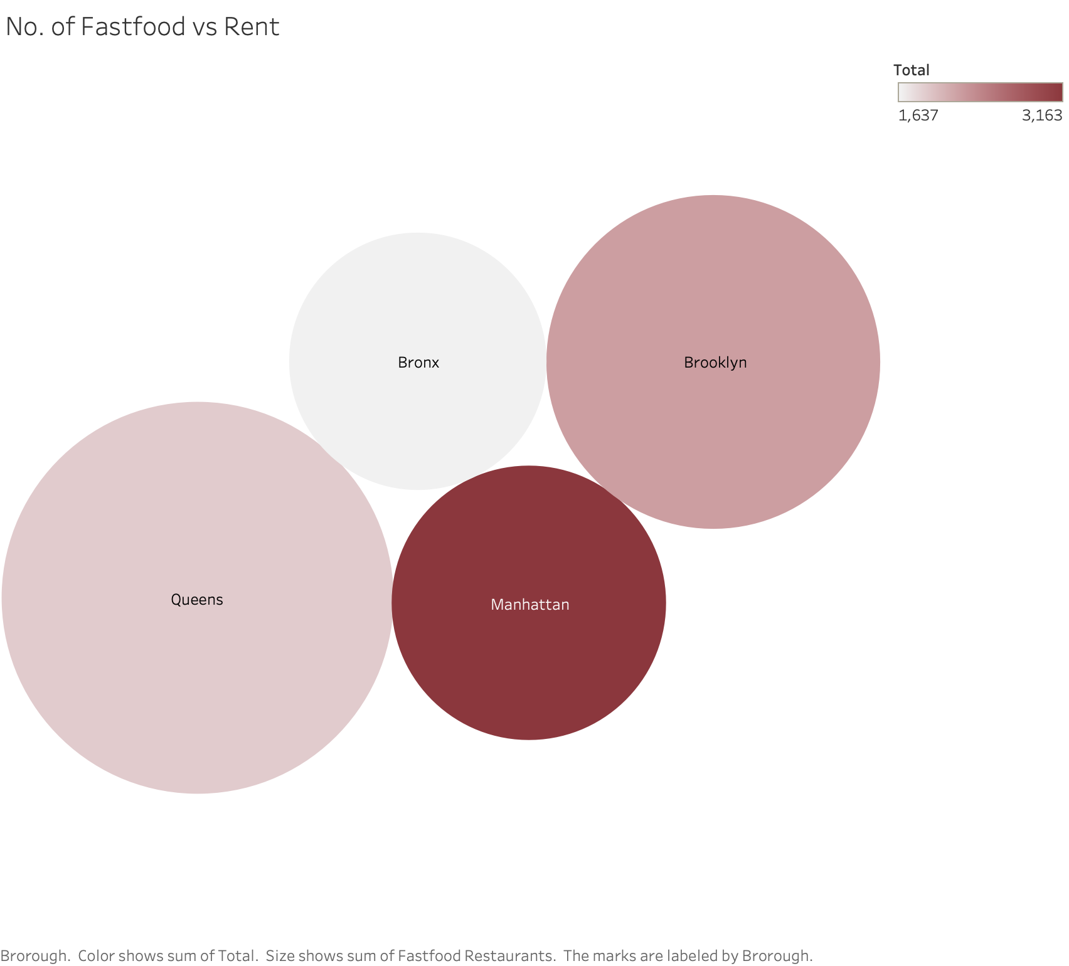
VS No. of FASTFOOD VENDORS
RENT
FINDINGS
Queens has the highest number of fast-food vendors followed by Brooklyn, Manhattan & Bronx
Manhattan has the highest rent

Slide 19
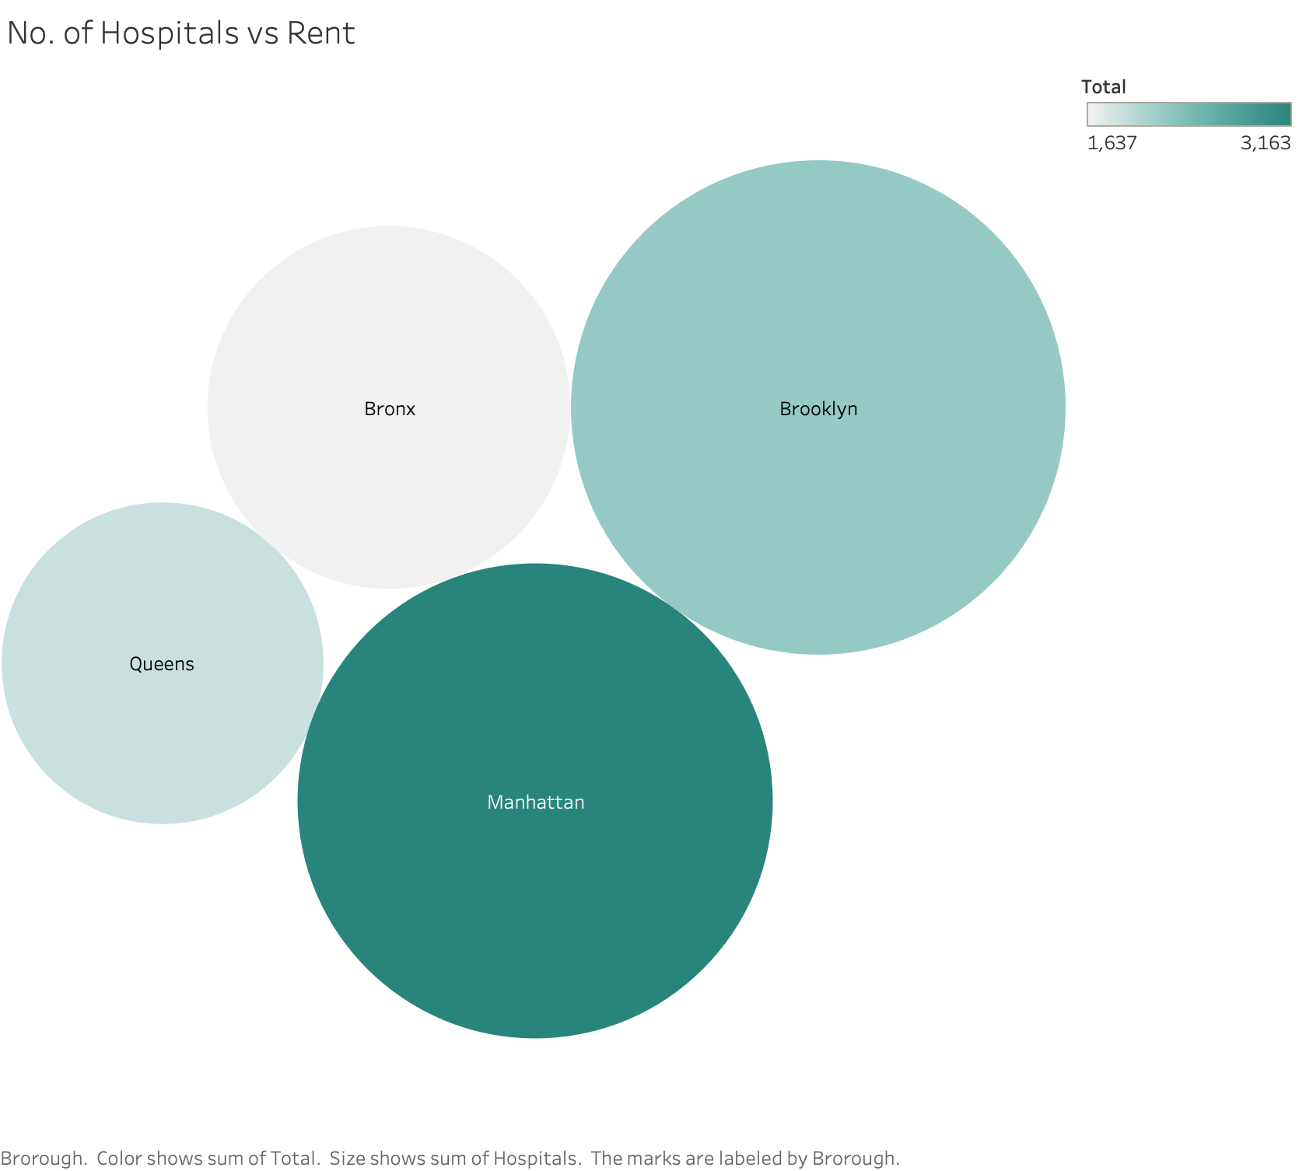
VS No. of HOSPITALS
Data ANALYSIS
RENT
FINDINGS
Brooklyn & Manhattan have the highest amount of hospitals
Manhattan has the highest amount of rent.

Slide 20
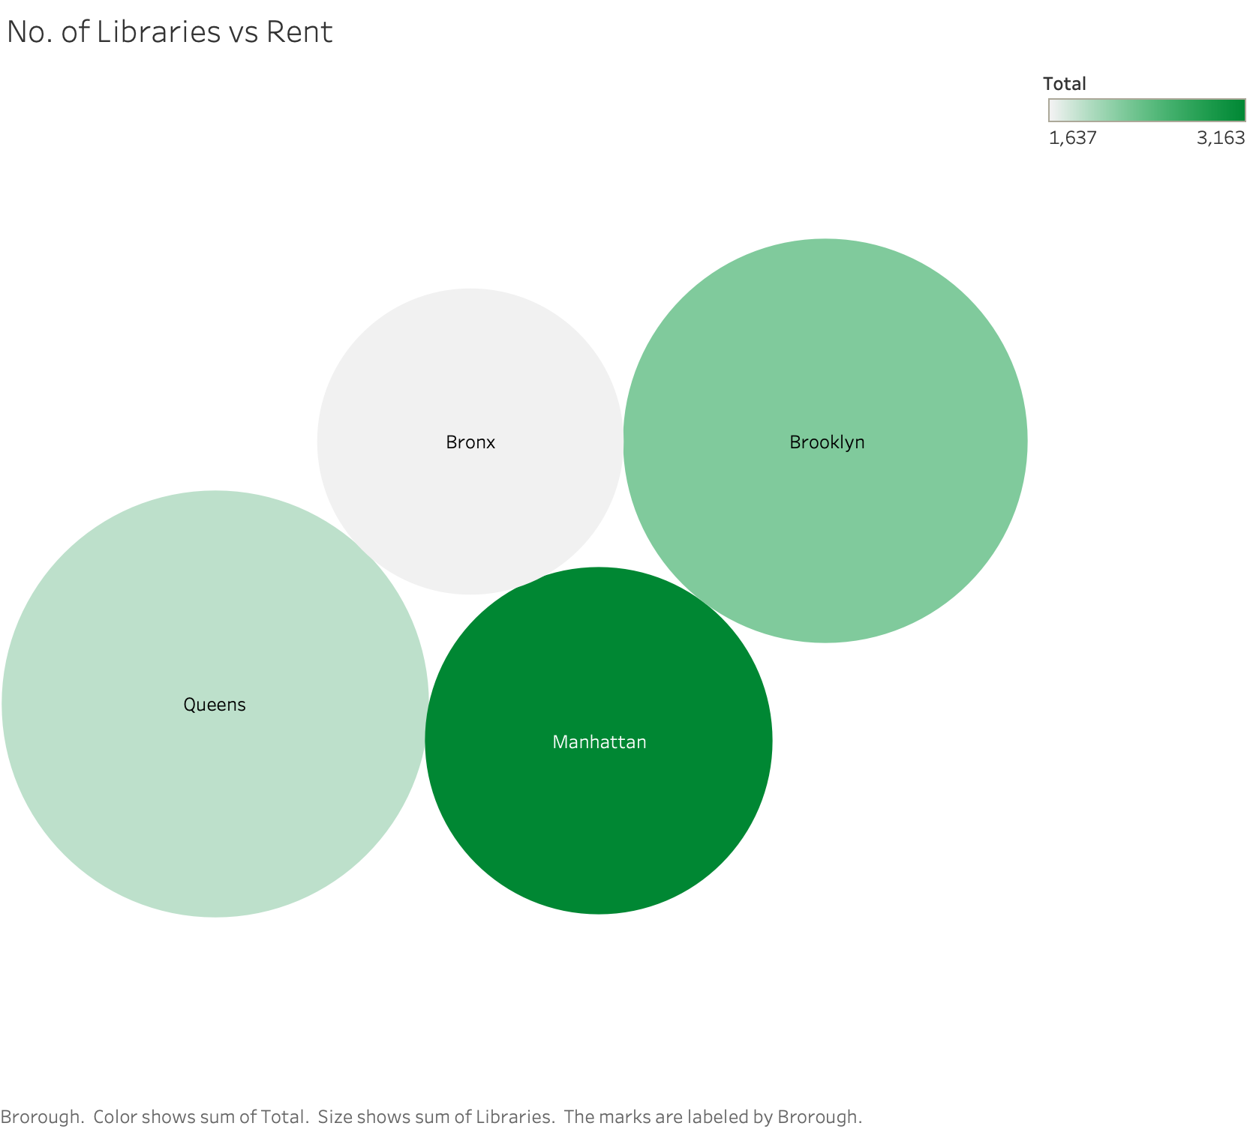
VS No. of LABRARIES
RENT
FINDINGS
Queens has the highest number of libraries followed by Brooklyn, Manhattan & Bronx
Manhattan has the highest rent

Slide 21
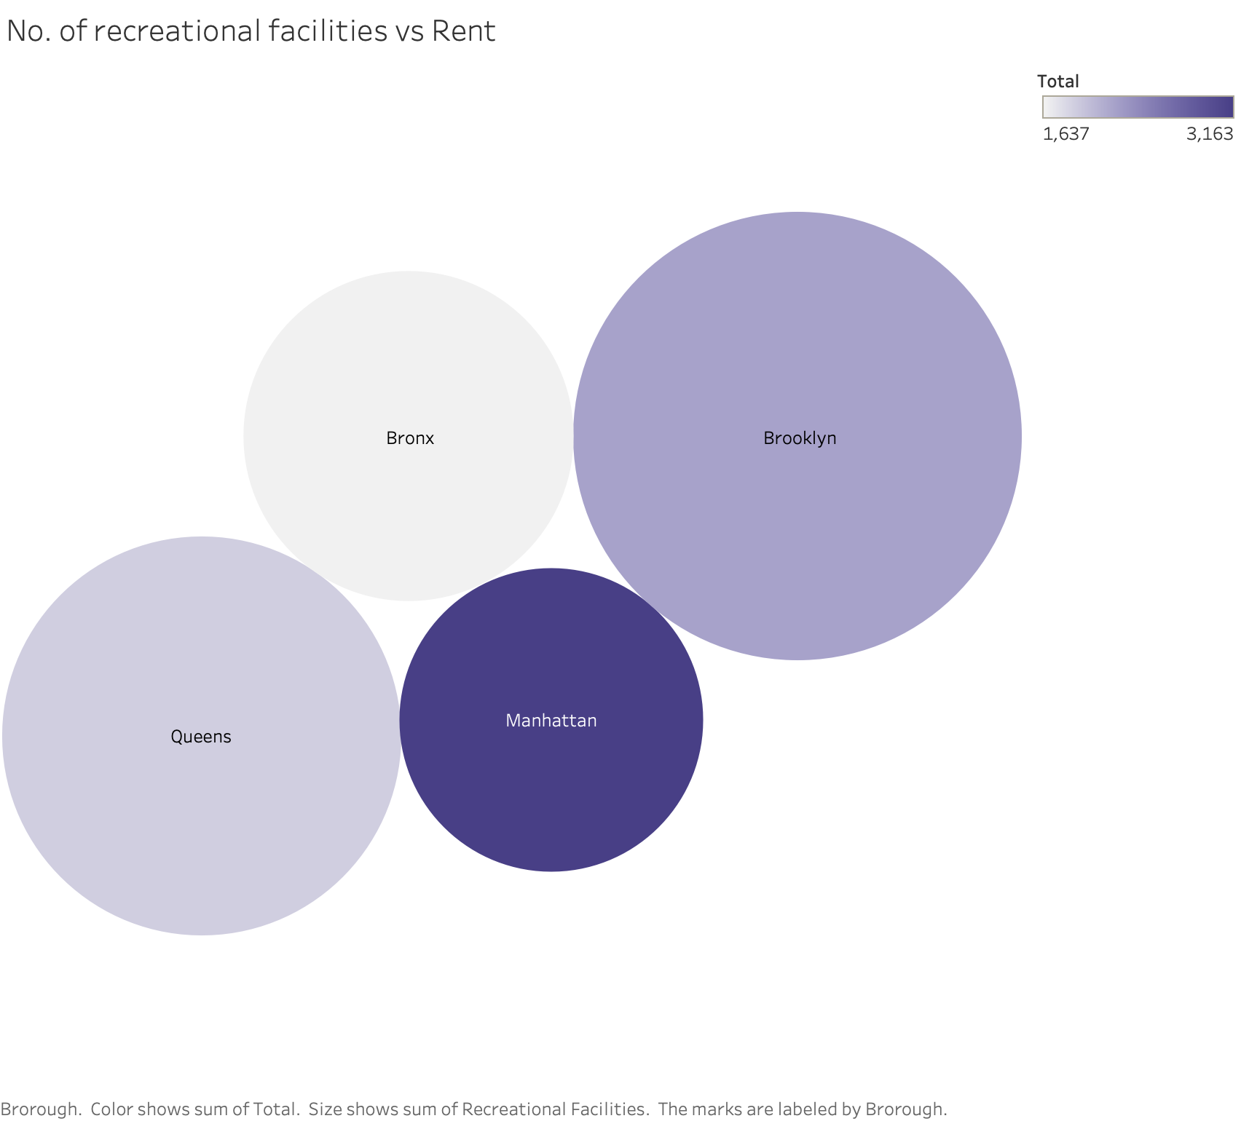
VS No. of recreational facilities
Data ANALYSIS
RENT
FINDINGS
Brooklyn has the highest amount of recreation facilities
Manhattan has the highest amount of rent.

Slide 22
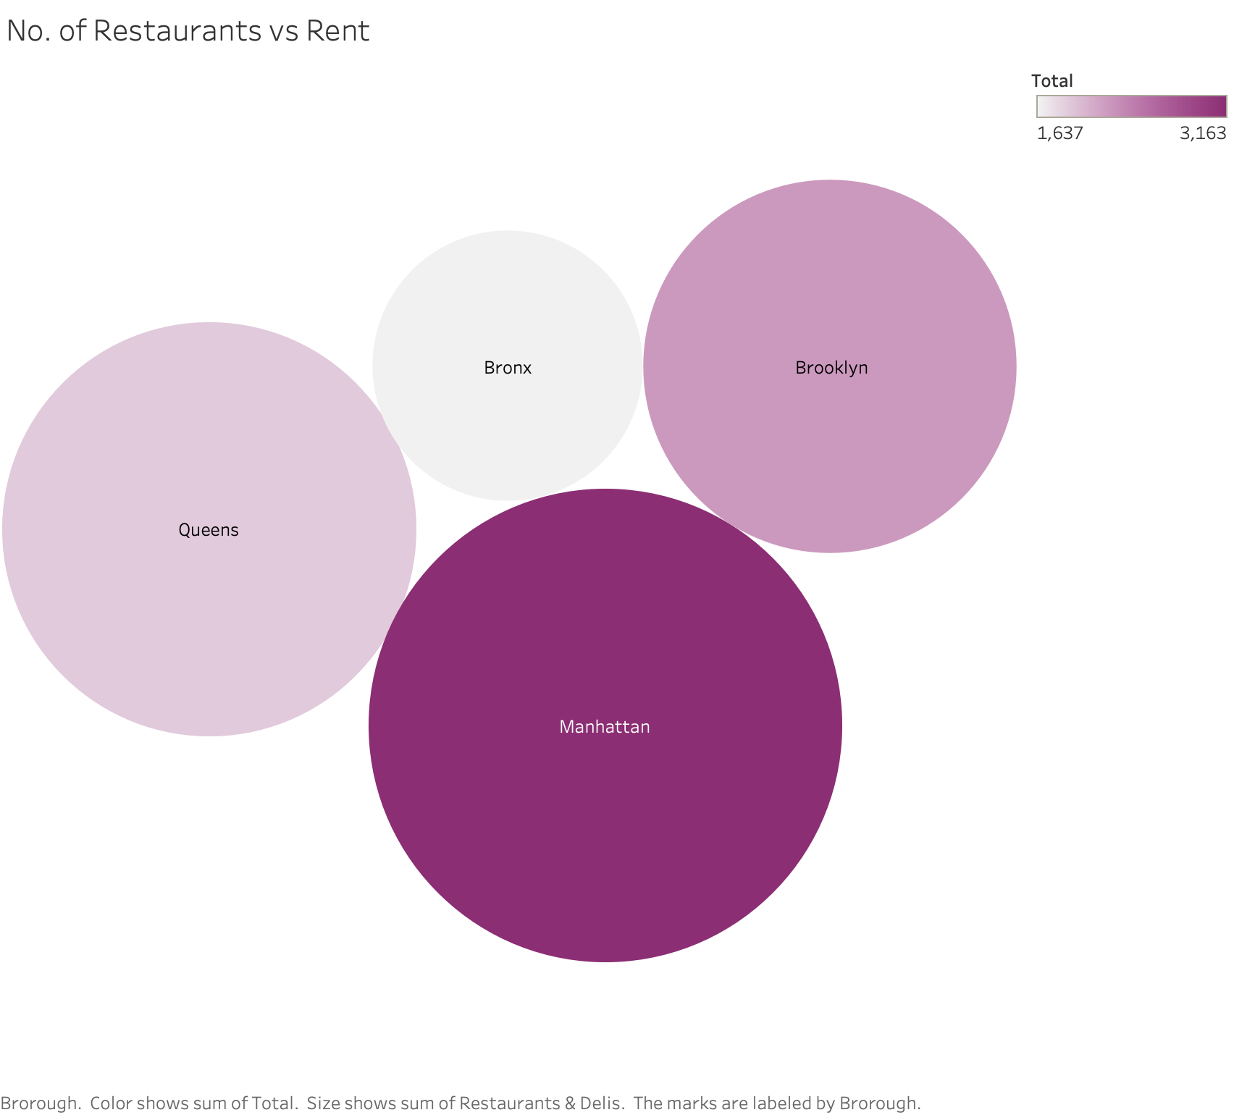
VS No. of Restaurants
RENT
FINDINGS
Manhattan has the highest number of restaurants followed by Queens & Brooklyn.
Manhattan has the highest rent

Slide 23
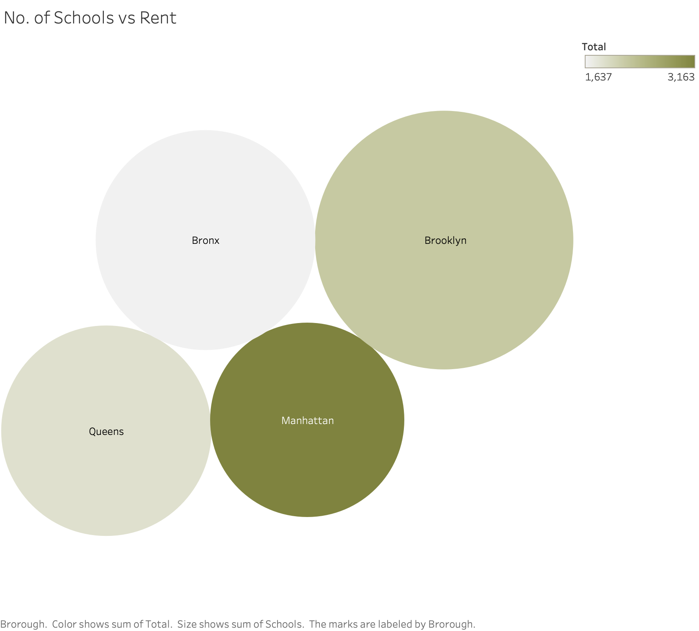
VS No. of Schools
Data ANALYSIS
RENT
FINDINGS
Brooklyn has the highest amount of recreation facilities
Manhattan has the highest amount of rent.

Slide 24
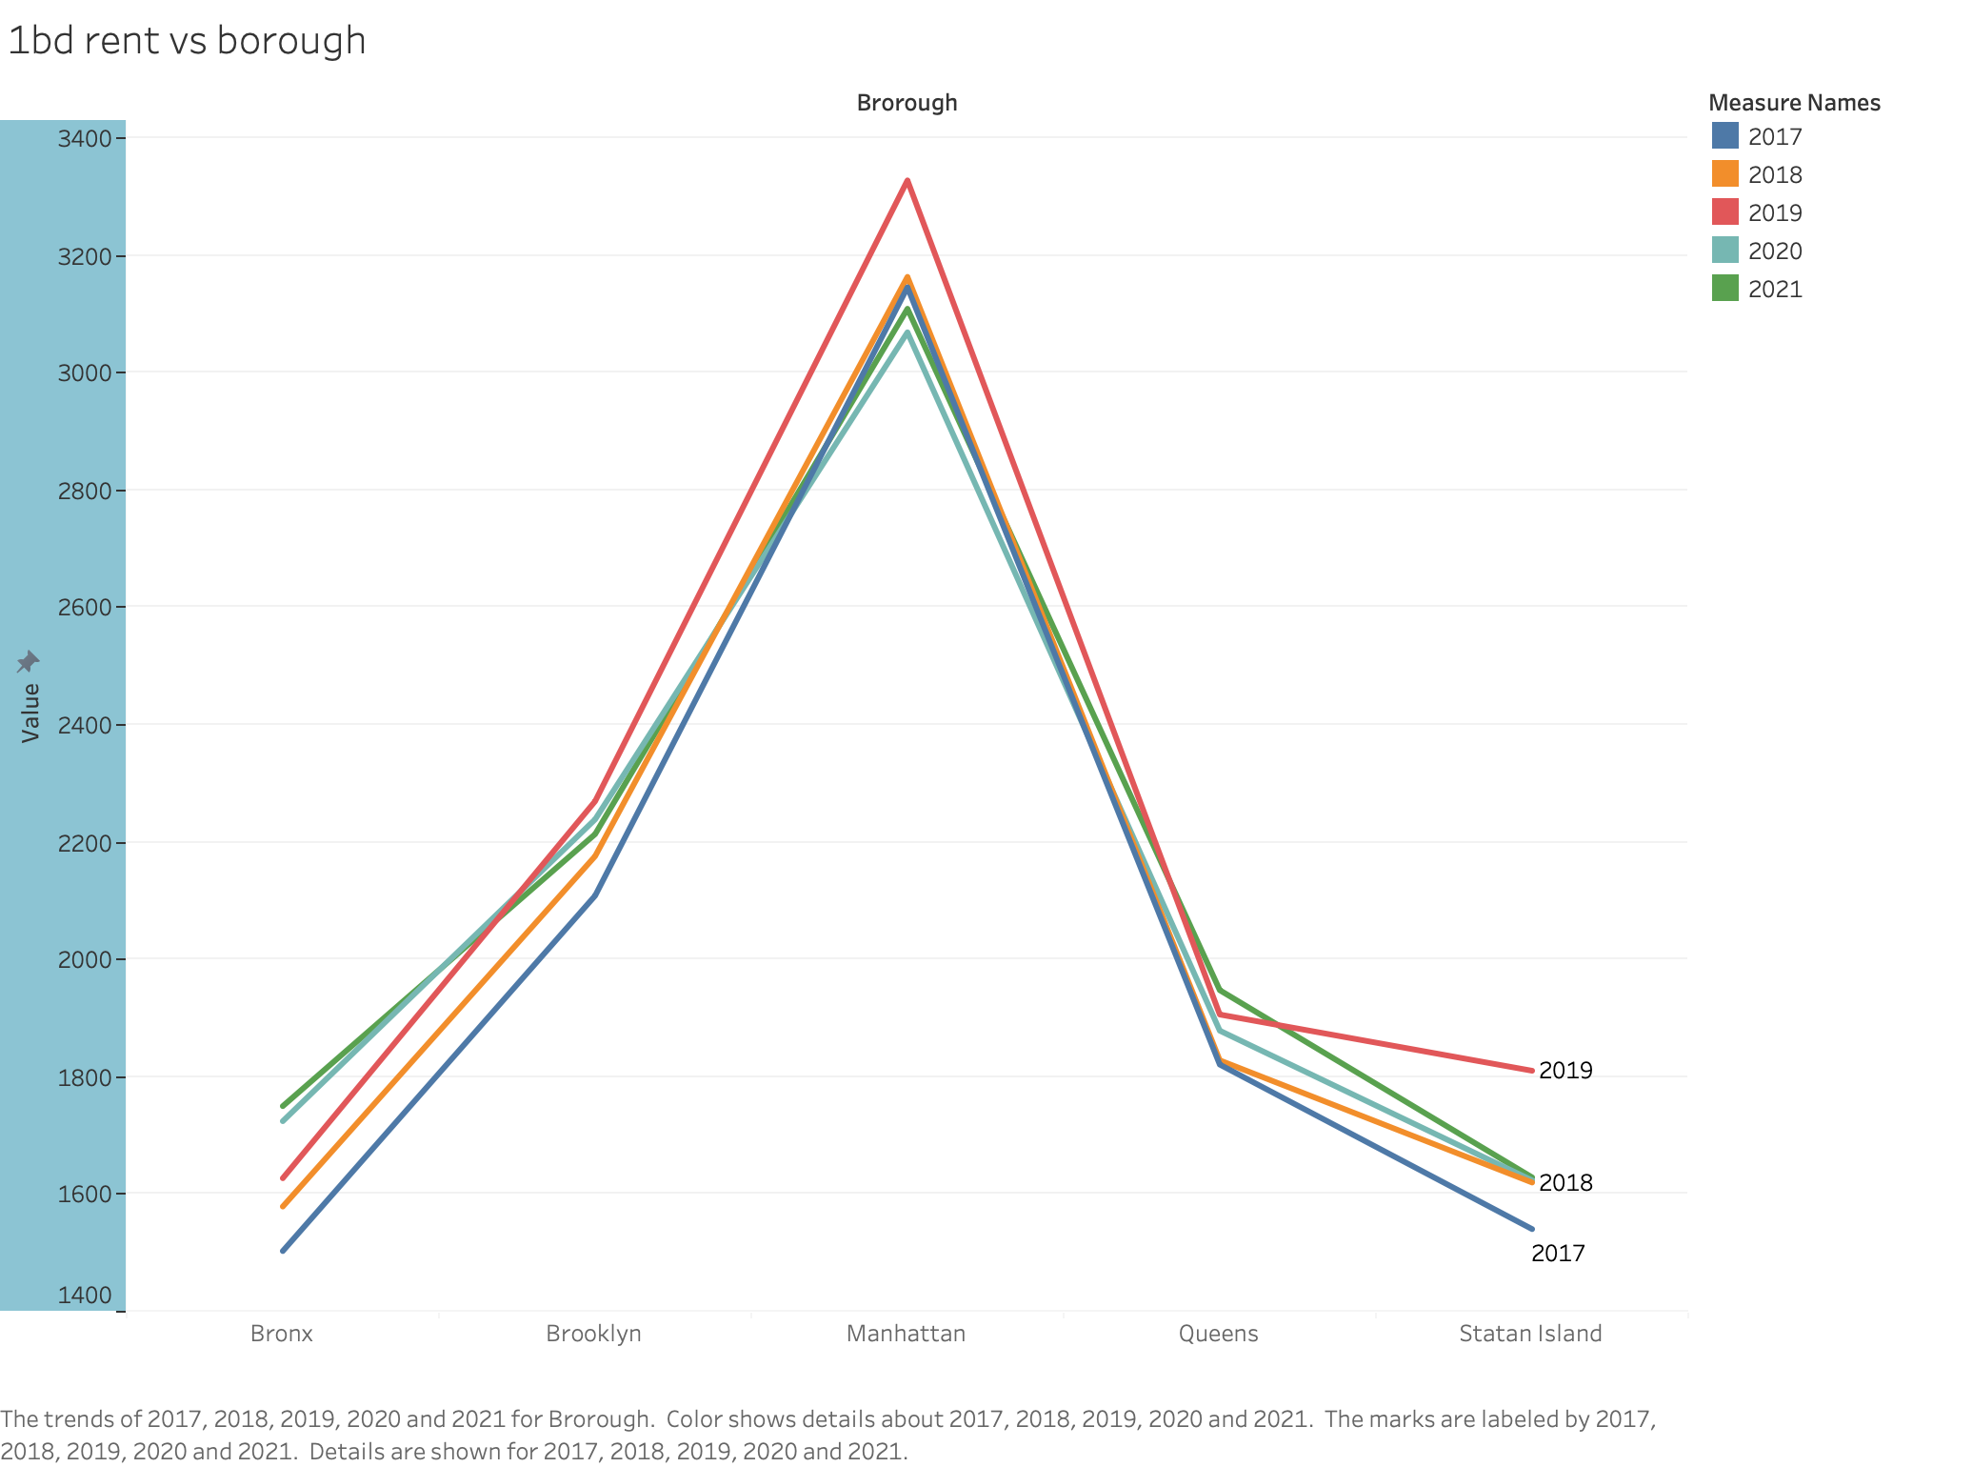
VS 1 Bed apartment rents
BOROUGHS
FINDINGS
Bronx & Queens have higher rent post pandemic
Rent in Manhattan has gone down post pandemic

Slide 25
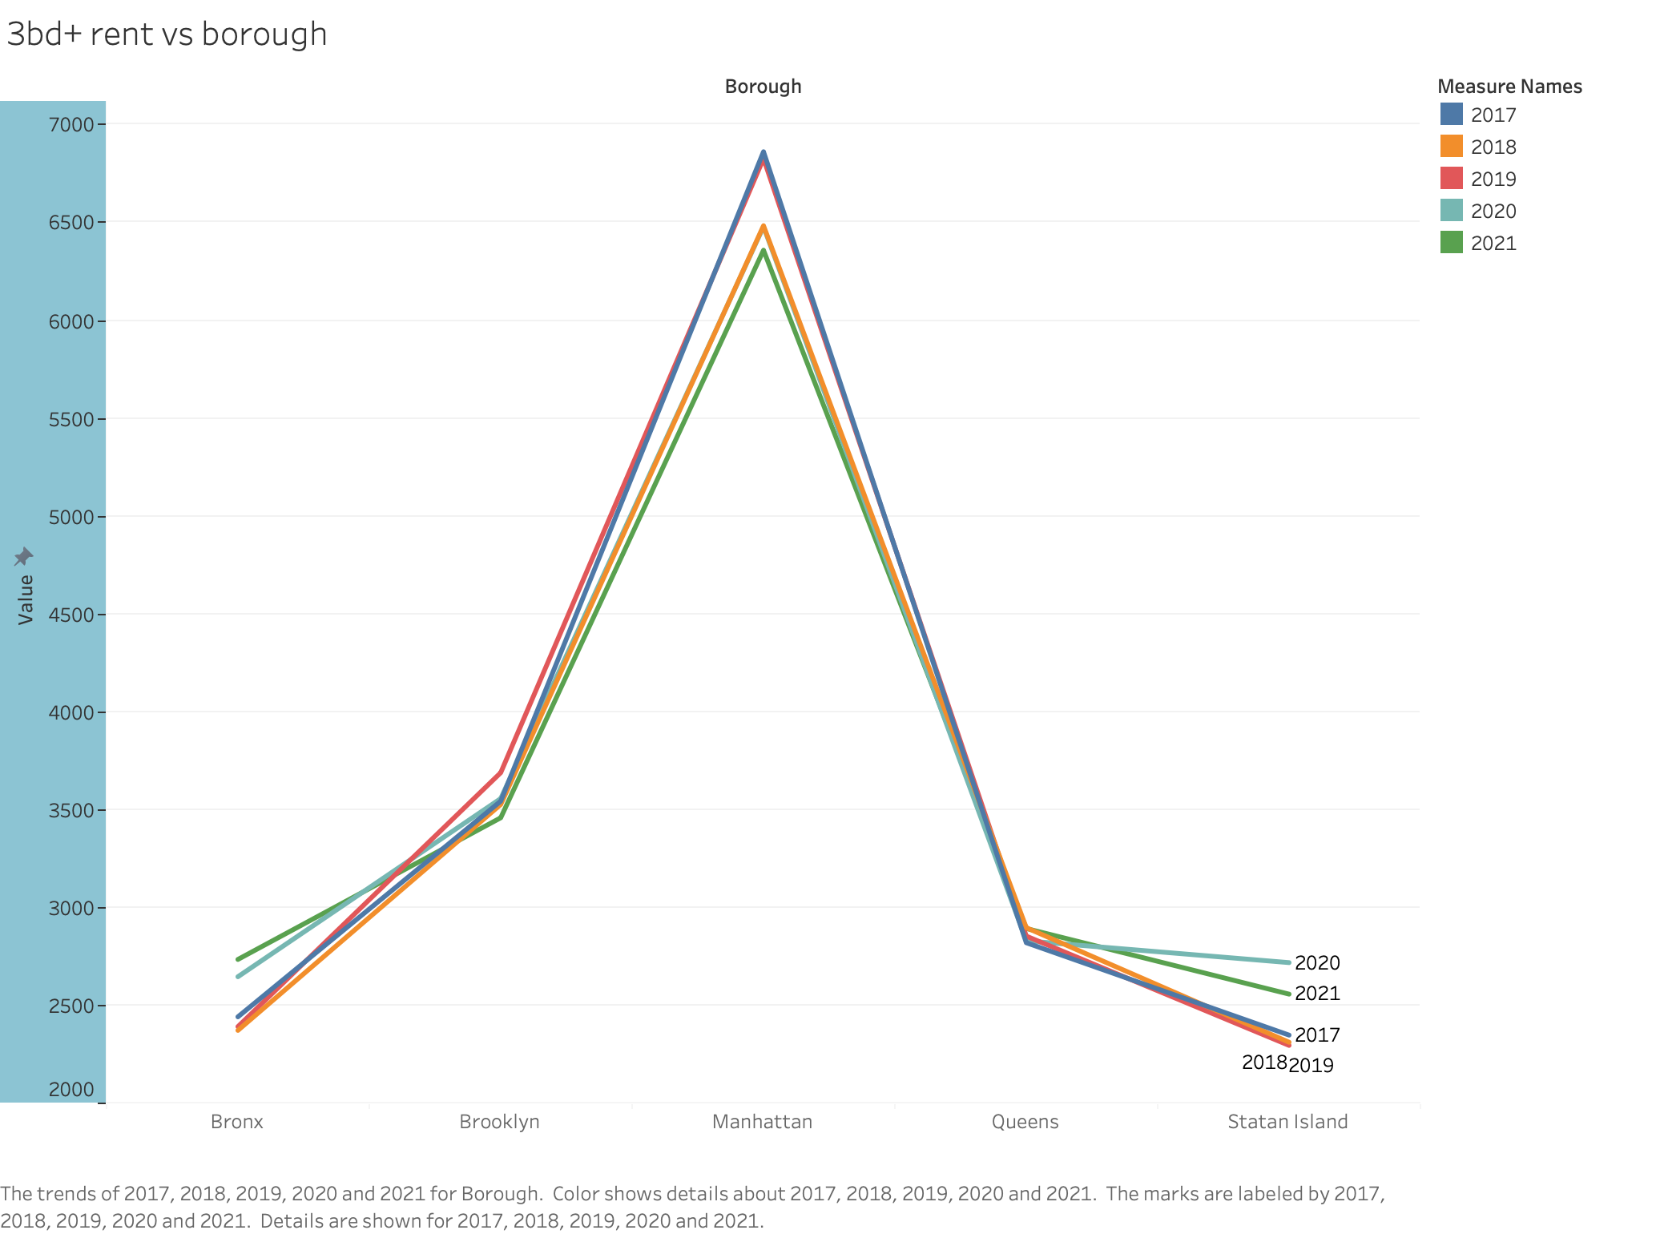
VS 3+ Bed apartment rents
Data ANALYSIS
BOROUGHS
FINDINGS
Bronx has seen an increase in rent post pandemic
Manhattan had the highest 3 Bed Apartment rent in 2017 and it has dropped to its lowest in 2021

Slide 26
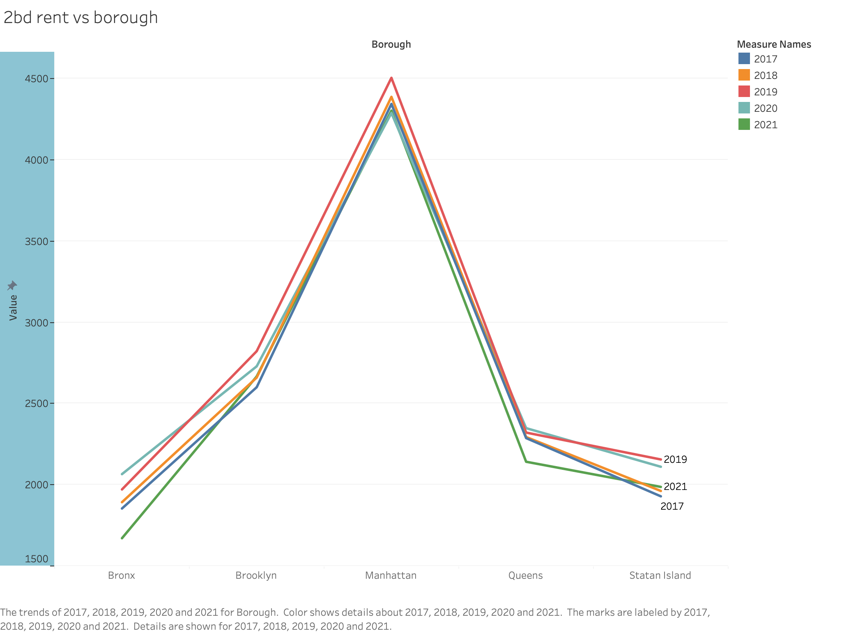
VS 2 Bed apartment rents
BOROUGHS
FINDINGS
Bronx & Queens have higher rent in 2020 and their lowest in 2021
Rent in Manhattan has gone down dramatically post pandemic

Slide 27
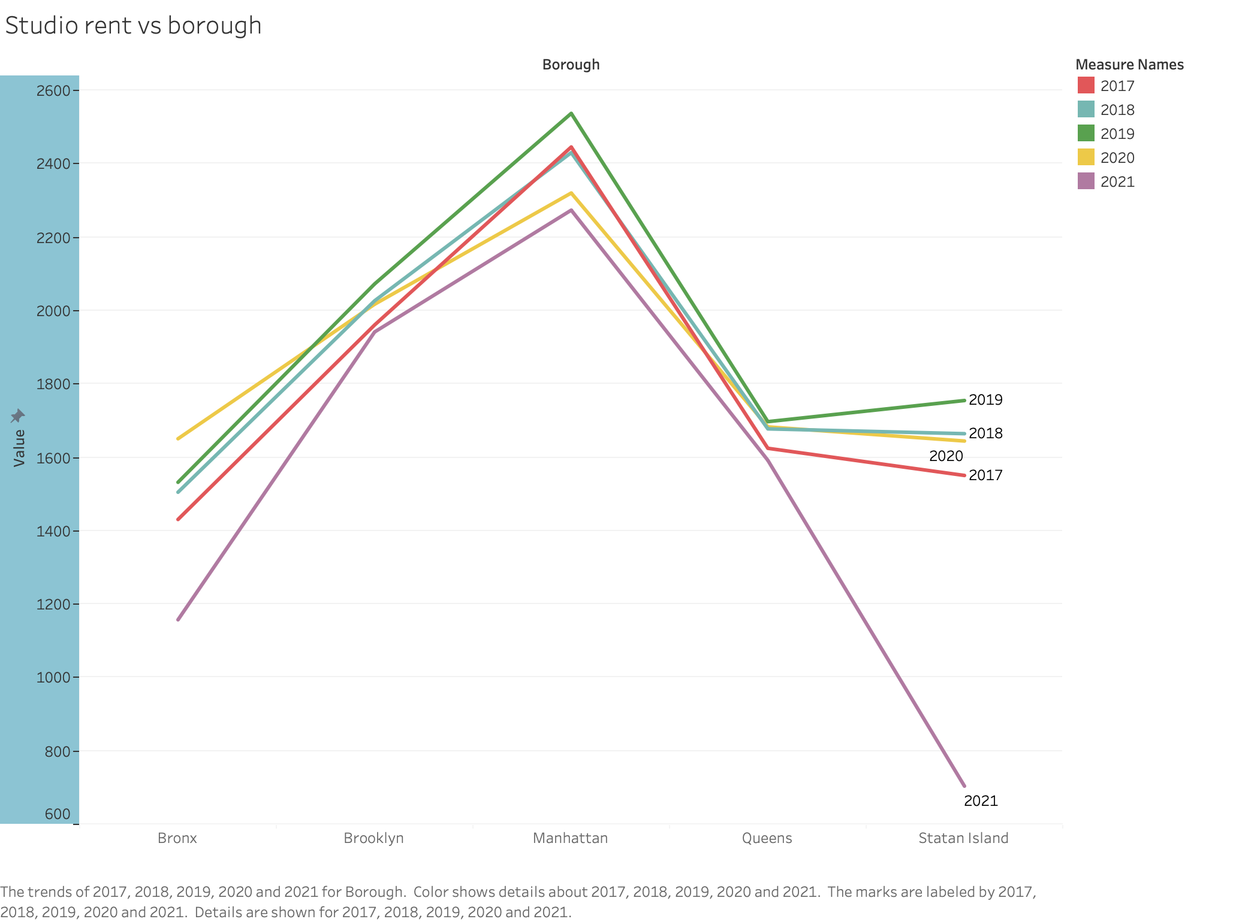
VS STUDIO apartment rents
Data ANALYSIS
BOROUGHS
FINDINGS
2021 saw the worst Studio rent across all boroughs
2019 saw the best rent across all boroughs except Bronx that saw a dip since 2020

Slide 28
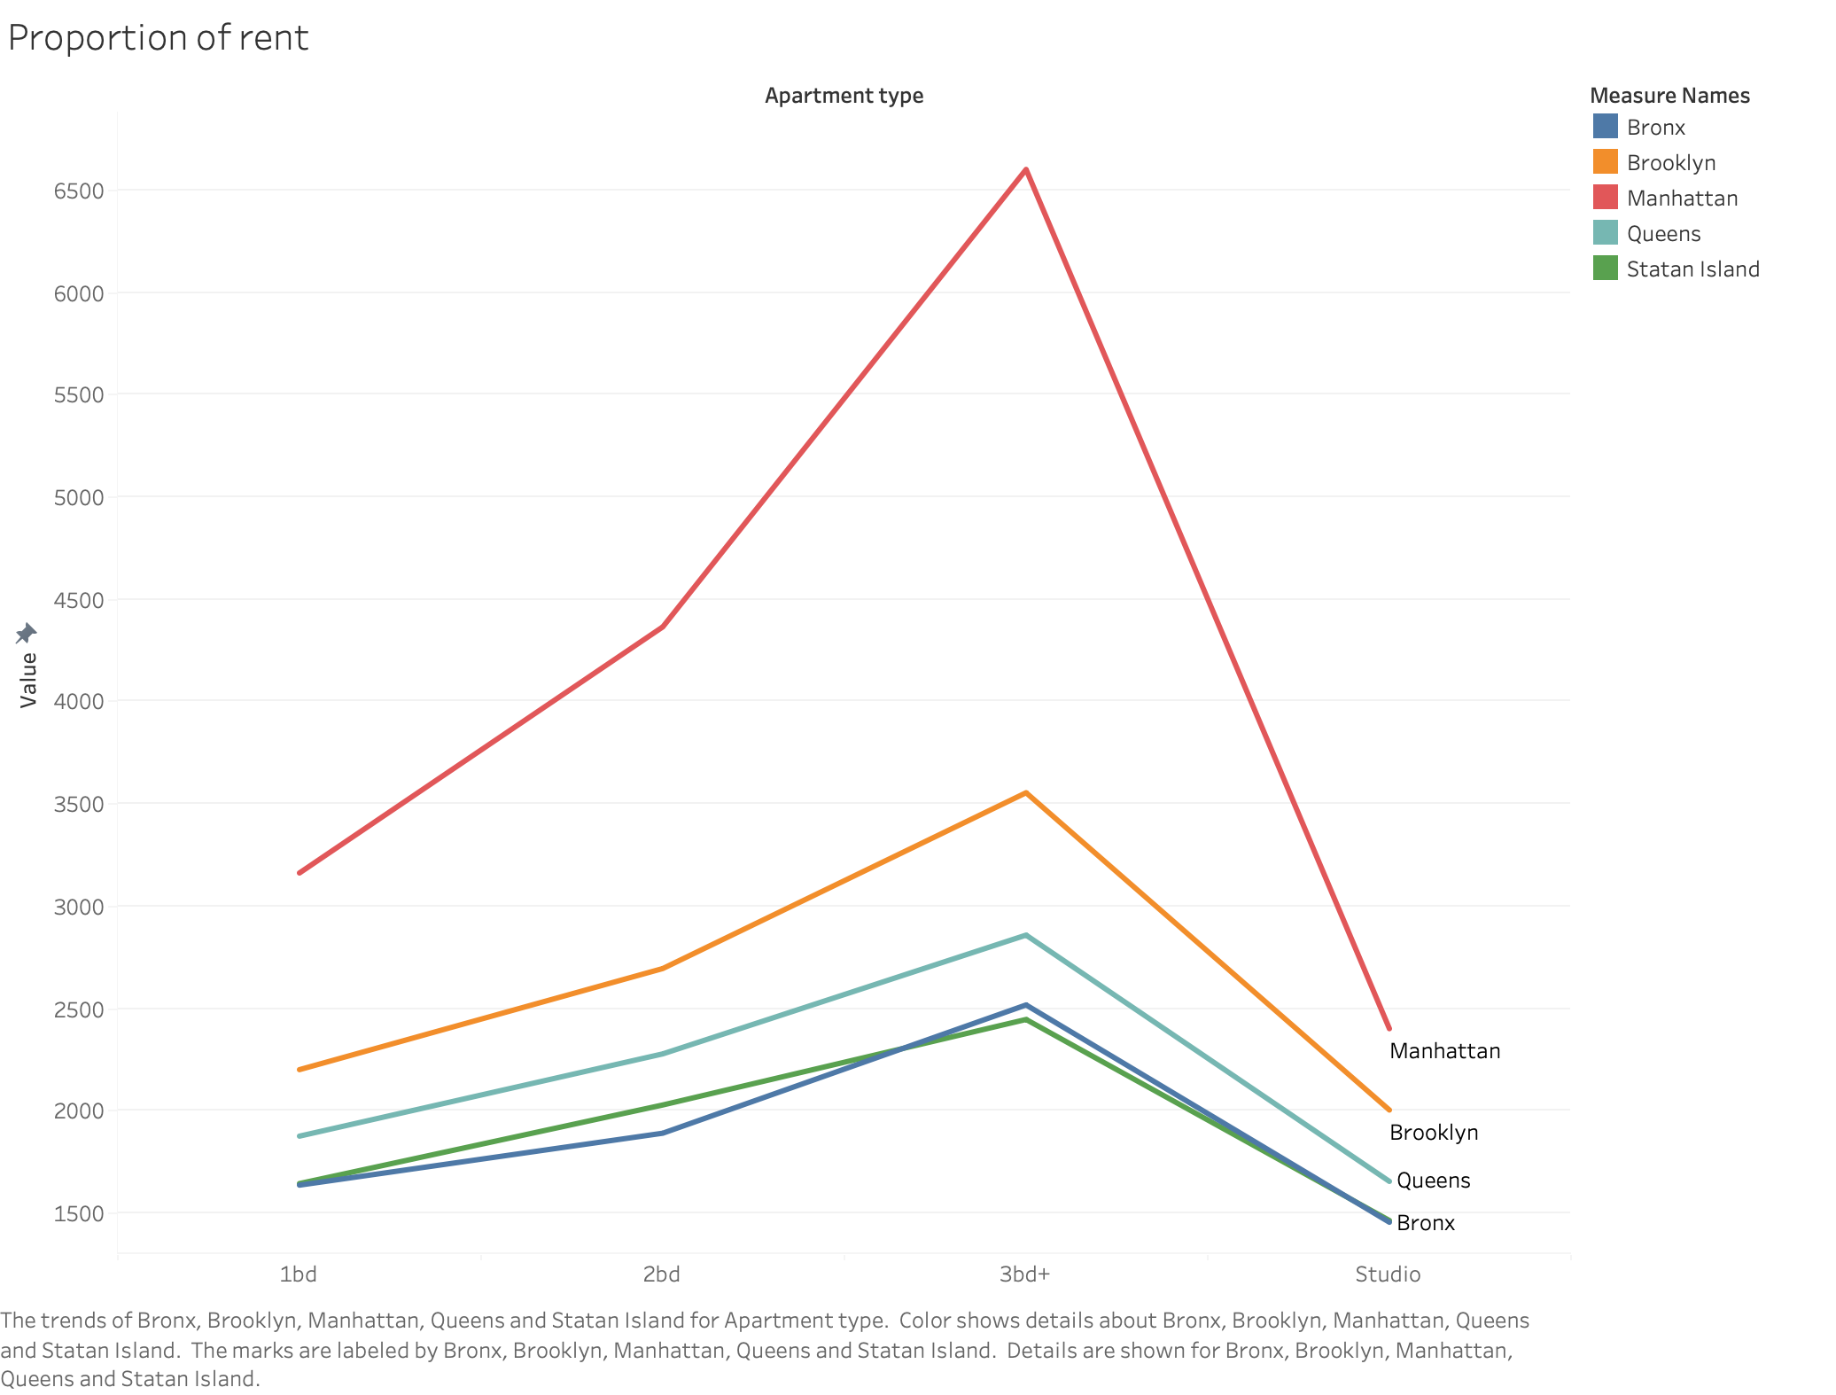
VS all apartment types
AVG RENT
FINDINGS
Bronx & Staten Island have similar rent distribution across apartment types
2 Bed Rent on average in Manhattan is higher than 3+ Bed rent in Brooklyn

Slide 29
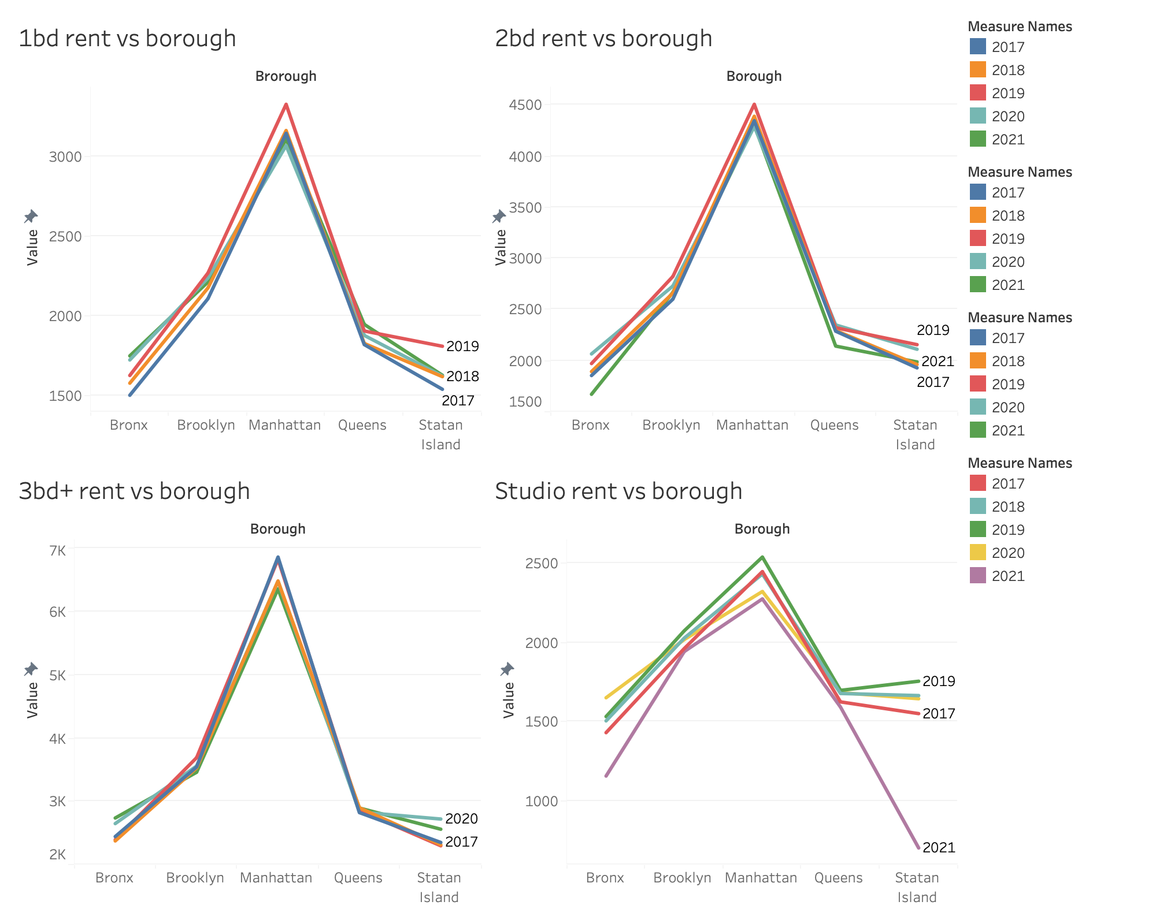
comparison DASHBOARD
Data ANALYSIS
COLLECTIVE

Slide 30
Model
04
Prescription
The model for rental apartments

Slide 31
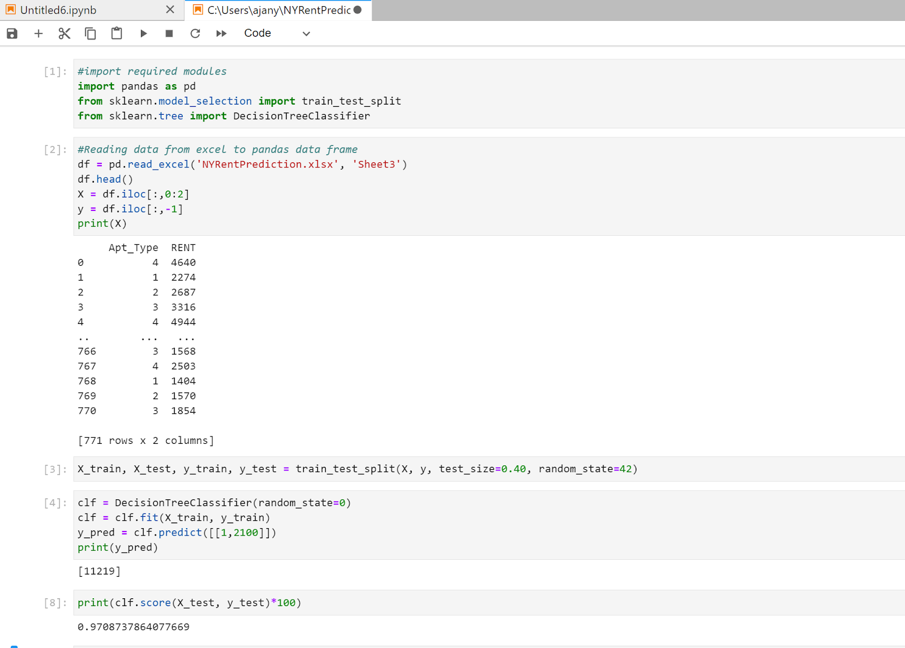
MOST PREFERRED AREA
This model has been implemented to identify most preferred Borough and area to rent in NYC as per user’s budget
The Decision tree model has been implemented in Python

Slide 32
Resources & methodologies used
Libraries used: Pandas which is an open-source Library written for the Python programming language for data manipulation and analysis.
Decision_Tree_Classifier: Used to perform multi-class classification on the data set.
Train_test_split: Used to split the data which is further used to predict the model accuracy. The model was trained with test size of 40% and random state of 42 %. Splitting criteria is Gini Index.
pd.readexcel: Read the excel file which has the rental data

Slide 33
Resources & METHODOLOGIES used
clf.predict: Predict the optimum area type to rent as per the budget.
Clf.score: Check model accuracy using “score” which is the mean accuracy on the given test data and labels. The score for this model is 0.97.
Apartment type is nominal type attribute and Rent has discrete value which can not be handled using linear regression.

Slide 34
THANKS!
WE ARE ALL OPEN TO questions!

